Slide 1
Gender Classification (based on any English text content)
QI,ZHAN JI,QI

Slide 2
Refresh
The goal of our project is trying to identify author’s gender by analyzing any text content he/she posted online such as tweets, facebook comments, youtube comments, facebook statuses, blog, even papers or other articles wrote with English.

Slide 3
Algorithm Detail
We will train our classifier by using a relatively uniform and balanced data set.
Among all the datasets instances of male and female text content will get similar amount and similar word count.

Slide 4
Algorithm Detail
Example
 | Male dataset | Female dataset
Amount of instances | 100 | 98
Word Count | 2000 | 10000
Not Uniform

Slide 5
Algorithm Detail
Example
 | Male dataset | Female dataset
Amount of instances | 100 | 98
Word Count | 2000 | 2020
Uniform

Slide 6
Three Features
We will use three features(scores) to judge an instance
Word Score
Suffix Score
Miscellaneous Score

Slide 7
Three Features
Word Score
We will build a word bag have format as below
No stop words
New words will get (50%,50%)
How to use these word bag?
on purpose typos count for a new word
Case-sensitive, count for a new word.

Slide 8
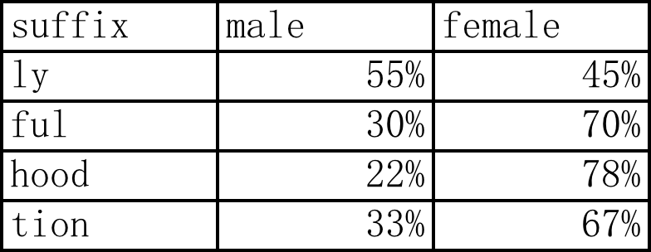
Three Features
Suffix Score
We will build another suffix bag have format as below
How to use this suffix bag? Same with the word bag.

Slide 9
Three Features
Miscellaneous Score
Link detection: according to other research, Given a male facebook status, it was twice as likely to have a youtube link than a female facebook status (.8% to .3%)
Emoticon detection: will build a emoticon bag with same format as word and suffix bag. Like ☺(27%, 73%) and <3 (8%,92%)
Number and Percentage detection: number and percentage in the instances will be assigned certain score like number(65%,35%)
Special punctuations detection: “……”,”?!!!”,”~~~~” will be used in calculate this score.

Slide 10
Three Features
Using the Scores
At the end of pre-processing function, all the text content will be transform to a number set like (100,50,-44)
Positive stands for male, negative stands for female.

Slide 11
Classifier Building
Use SVM, KNN to train and predict
Fit number set with target class by using scikit learn.
Adjust weight of three feature, trying to find the most effective combination.
Expected accuracy is 60%-70%.

Slide 12
Classifier Building
Result compare, accuracy improve
Labeled data is limited, 3000 blogs, will divide them into 2 uniform groups (or more), train with group one then test with group 2, then switch.
Train with all the labeled data then test with random labeled data.

Slide 13
Thank you !

